Slide 1
DENTAL PLAQUE
RUNGTA COLLEGE OF DENTAL SCIENCES AND RESEARCH,BHILAI
DR PUSHPENDRA YADAV
SR. LECTURER
DEPT OF PERIODONTOLOGY

Slide 2
SPECIFIC LEARNING OBJECTIVES
CORE AREAS | DOMAIN | CATEGORY
Introduction | Affective | Desire to know
Definition | Cognitive | Must to know
Composition | Cognitive | Must to know
Changing views of plaque | Cognitive | Must to know
Plaque as a biofilm | Cognitive | Must to know
Plaque formation at ultrastructural level | Cognitive | Must to know
Physiologic properties | Cognitive | Must to know

Slide 3
SPECIFIC LEARNING OBJECTIVES
CORE AREAS | DOMAIN | CATEGORY
Changing concepts of dental plaque | Cognitive | Must to know
Microbial specificity of disease | Cognitive | Must to know
Complicating factors in periodontal therapy | Cognitive | Must to know
Identification of periodontal pathogens | Cognitive | Must to know
Microorganism associated with specific periodontal disease | Cognitive | Must to know
Pathogenicity and biofilm | Cognitive | Must to know

Slide 4
CONTENTS
PART-I
Introduction
Definition
Composition
Changing views of plaque
Plaque as a biofilm
Plaque formation at ultrastructural level
De novo supragingival plaque formation
De novo subgingival plaque formation
Physiologic properties
Priniciple of bacterial transmission
Changing concepts of dental plaque
Summary
References

Slide 5
CONTENTS
PART II
Microbial specificity of disease
Key characteristics of periodontal pathogens
Summary
References

Slide 6
MICROBIAL SPECIFICITY OF PERIODONTAL DISEASE
Non Specific Plaque Hypothesis
Specific Plaque Hypothesis
Ecologic Plaque Hypothesis

Slide 7
NON SPECIFIC PLAQUE HYPOTHESIS
Proposed by W.D. Miller in 1973, Walter J Loesche 1976, Theilade 1986
Nonspecific plaque hypothesis states that periodontal disease results from the “elaboration of noxious products by the entire plaque flora”.

Slide 8
SPECIFIC PLAQUE HYPOTHESIS
Proposed by…..Loesche 1976
Only certain plaque is pathogenic.
Pathogenicity depends on the presence of or increase in specific microorganisms.

Slide 9
Actinomyces, spirochetes and gram negative rods
P.gingivalis, P.intermedia, A. Actinomycetem comitans

Slide 10
Ecological Plaque Hypothesis
proposed by Marsh et al in 1990
According to this:
a change in a key environmental factor (or factors) will trigger a shift in the balance of the resident plaque microflora, and this might predispose a site to disease.

Slide 11
Microbial Shift During Disease…..
From gram positive to gram negative.
From cocci to rods
From nonmotile to motile organisms.
From facultative anaerobes to obligate anaerobes.
From fermenting to proteolytic species.

Slide 12
CRITERIA FOR THE IDENTIFICATION OF PERIODONTAL PATHOGEN
Koch’s postulates :
Must be routinely isolated from diseased individuals.
Must be grown pure culture in the laboratory.
Must produce similar disease when inoculated into susceptible laboratory animals.
Must be recovered from lesions in a diseased laboratory animal.

Slide 13
CRITERIA FOR THE IDENTIFICATION OF PERIODONTAL PATHOGEN
Contradictions:
Inability to culture all the organisms.
Difficulty in defining and culturing sites.
Lack of good animal model system

Slide 14
Microorganism associated with specific periodontal disease
Periodontal health
Gingivitis
Chronic periodontitis
Aggressive periodontitis
Necrotizing ulcerative gingivitis/periodontitis
Periodontal abscess

Slide 15
Periodontal health…
Gram-positive facultative species: streptococcus and Actinomyces spp
Gram-negative species : P. intermedia, F. nucleatum, and Capnocytophaga, Neisseria, and Veillonella species, spirochetes and motile rods
Protective or beneficial species to the host : S. sanguis, Veillonella parvula, and C. ochraceus

Slide 16
Gingivitis…
Gram-positive - 56% (S. sanguis, S. mitis, S. intermedius, S. oralis, A. viscosus, A. naeslundii, and P. micros. )
Facultative anaerobes – 59%, anaerobic - 41% microorganisms.
Gram-negative – 44% ..F. nucleatum, P. intermedia, and V. parvula, Haemophilus, Capnocytophaga, and Campylobacter species

Slide 17
Chronic periodontitis….
C. rectus, P. gingivalis, P. intermedia, F. nucleatum, and T. forsythia were found to be elevated in the active sites
Anaerobic (90%), gram-negative (75%) and spirochetes
P. gingivalis, T. forsythia, P. intermedia, C. rectus, E. corrodens, F. nucleatum, A. actinomycetemcomitans, P. micros, and Treponema and Eubacterium.

Slide 18
Localized aggressive periodontitis…
Gram-negative, capnophilic, and anaerobic rods.
Almost all disease sites harbor A. actinomycetemcomitans.
Herpesviruses, including EBV-1 and HCMV

Slide 19
Generalized Aggressive Periodontitis…
Similar sub-gingival flora
P. gingivalis, T. forsythis A. actinomycetemcomitans, and Campylobacter species.

Slide 20
Refractory Periodontitis…
Unusually diverse and may contain enteric rods, staphylococci, and Candida.
P. gingivalis, T. forsythis, S. inter-medius, P. intermedia, Peptostreptococcus micros, and Eikenella corrodens.
Persistence of Streptococcus constellatus has also been reported.

Slide 21
Necrotizing Ulcerative Gingivitis/Periodontitis …
>50% strict anaerobes
Spirochetes …..predominant organism.
P. gingivalis and F. nucleatum

Slide 22
Periodontal Abscess…
70% gram-negative and about 50% are anaerobic rods.
Enteric bacteria, coagulase-negative staphylococci, and Candida albicans have also been detected
F. nucleatum , P. micros , P. intermedia, P. gingivalis, and T. forsythus.

Slide 23
KEY CHARACTERISTICS OF SPECIFIC PERIOPATHOGENS
Aggregatibacter actinomycetemcomitans
Tannerella forsythia
Porphyromonas gingivalis
Prevotella
Campylobacter rectus
Fusobacterium nucleatum
Peptostreptococcus micros
Salmonella species
Eubacterium species
Spirochetes

Slide 24
Aggregatibacter actinomycetemcomitans
Nonmotile and gram negative.
Small, short (0.4-1 μm), straight or curved rod with rounded ends.
Multiple biotypes
Six serotypes (a to f) based on differences in polysaccharide composition

Slide 25
SPECIFIC MEDIUM
NONSPECIFIC MEDIUM

Slide 26
Tannerella forsythia
Gram-negative obligate anaerobe.
Nonmotile, spindle-shaped, highly pleomorphic rod
Culture conditions and identification: Grows slowly (14 days for minute colonies) only under anaerobic conditions and needs several growth factors (e.g., N-acetylmuramic acid) from other species (e.g., F. nucleatum).

Slide 27
Pathogenicity:
Produces several proteolytic enzymes that are able to destroy immunoglobulins and factors of the complement system.
Induces apoptotic cell death
Trypsin like proteolytic activity
Expression of pro-inflammatory cytokines, chemokines,PGE2, MMP9

Slide 28
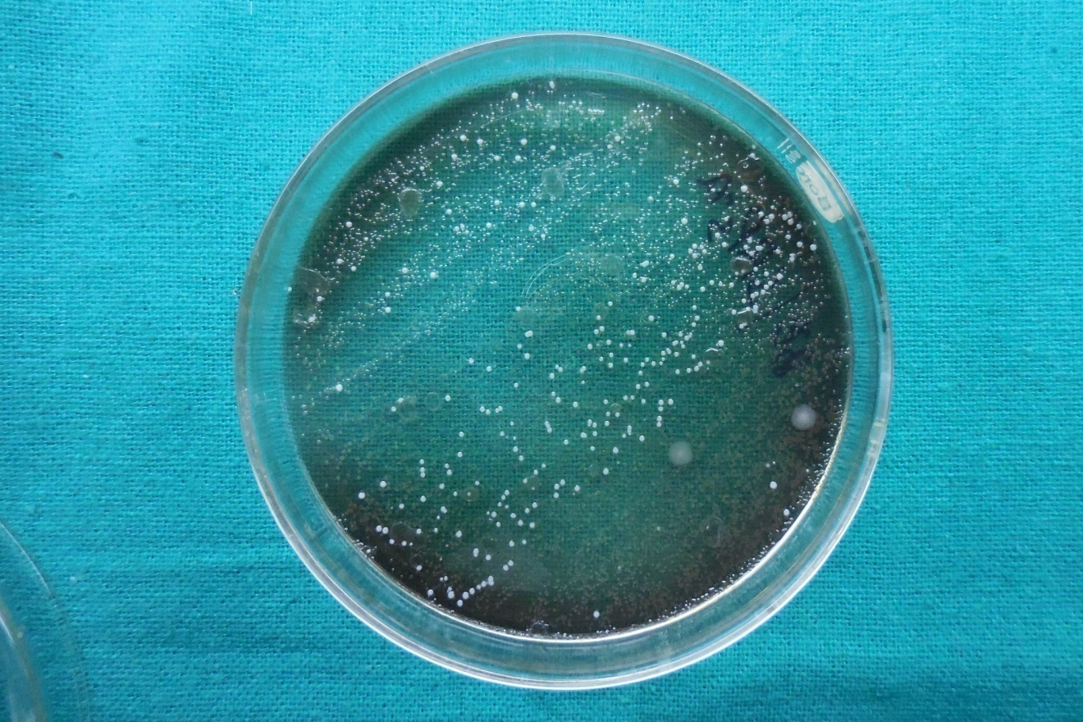
Bile esculin media showing growth of T. forsythia

Slide 29
Porphyromonas gingivalis
Gram-negative obligate anaerobe
Nonmotile, pleomorphic rod
Forms: Based on the capsule type, different genotypes have been described.
Culture conditions and identification: Grows anaerobically with dark pigmentation on blood agar because of a metabolic end product from blood (hemin).

Slide 30
Fulfilling socransky criteria….
Virulence Factors : Collagenase, trypsin-like enzyme, fibrinolysin, immunoglobulin degrading enzymes, other proteases, gingipain, phospholipase A, phosphatases, endotoxin, hydrogen sulfate, ammonia, fatty acids and other factors that compromise PMN function.
Animal Studies : Onset of disease correlated with colonization in monkey model.

Slide 31
Special pathogenic characteristics:
Fimbriae mediate adhesion.
Capsule defends against phagocytosis.
Gingipain, proteases, hemolysin, collagenase, endotoxin.
Extracellular vesicles causing loss of CD14 receptors

Slide 32
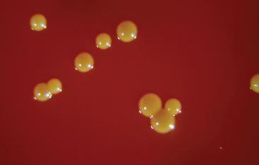
Nonspecific blood-agar petri dish…..

Slide 33
Prevotella
Short, round-ended, nonmotile, gram-negative rods.
P. intermedia and P. nigrescens are the most pathogenic.
Culture conditions and identification: Grow anaerobically, with dark pigmentation (brown-black colonies) on blood agar.
Special pathogenic characteristics: Less virulent and less proteolytic than P. gingivalis.

Slide 34
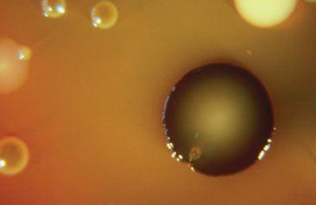
Colony morphology of a P. intermedia strain (large black colony) on a nonspecific blood-agar Petridish.

Slide 35
Campylobacter rectus
Motile gram-negative, short rod, curved (vibrio) or helical.
Motility results from the polar flagellum.
Culture conditions and identification: Grows anaerobically with dark pigmentation when sulfide is added to the medium, which is transformed to iron sulphide, giving a gray stain.

Slide 36
Campylobacter rectus
Special pathogenic characteristics: Produces leukotoxin.
C. rectus is less virulent and less proteolytic than P. gingivalis.

Slide 37
Fusobacterium nucleatum
Gram-negative, cigar-shaped bacillus with pointed ends.
Forms: Several subspecies (ss) are classified, including F. nucleatum ss nucleatum, F. nucleatum ss polymorphum, F. nucleatum ss vincentii, and F. periodonticum.
Culture conditions and identification: Grows anaerobically on blood agar and can easily be identified on a specific medium

Slide 38
Fusobacterium nucleatum
Special pathogenic characteristics: Induce apoptotic cell death in mononuclear and polymorphonuclear cells and can trigger the release of cytokines, elastase, and oxygen radicals from leukocytes.

Slide 39
A. specific medium (purple colonies) B. with Gram stain

Slide 40
PEPTOSTREPTOCOCCUS MICROS
Gram positive, anaerobic, small, asaccharolytic coccus.
Two genotypes can be distinguished with the smooth genotype being more frequently associated with periodontitis lesions than the rough genotype.

Slide 41
SALMONELLA SPECIES
Gram negative, curved, saccharolytic rods
Presence of a tuft of flagella inserted in the concave side.
six genetically and phenotypically distinct groups isolated from oral cavity and S. noxia found at a higher proportion of shallow sites (PD>4mm) in chronic periodontitis.

Slide 42
EUBACTERIUM SPECIES
Suggested as possible periodontal pathogens due to their increased levels in disease sites.
E. nodatum, Eubacterium brachy and Eubacterium timidum are Gram positive, strictly anaerobic, small somewhat pleomorphic rods.

Slide 43
SPIROCHETES
Spiral, motile organisms
Helical rods - 5 to 15 μm long with a diameter of 0.5 μm.
Cell wall is gram negative, but they stain poorly.

Slide 44
SPIROCHETES
Forms: Treponema denticola, Treponema vincentii, Treponema socranskii (often associated with periodontitis), and Treponema pallidum (associated with secondary syphilis).
Culture conditions and identification: Oral spirochetes are extremely difficult to grow and need strict anaerobic conditions and a specific medium.

Slide 45
Estimation of the virulence of plaque biofilm
Bacterial culture techniques
Immunologic analyses
Enzymatic assays
DNA probe technology

Slide 46
SUMMARY
After weaning (>2 years), the entire human microbiota is formed and comprises a very complex collection of hundreds of different types of bacteria that totals to approximately 1014 microbial cells.
Dental plaque is composed primarily of microorganisms
encased within an extracellular matrix. One gram of plaque
(wet weight) contains approximately 1011 bacteria.

Slide 47
REFERENCE
Newman MG, Takei HH, Klokkevold PR, Carranza FA. Carranza’s clinical periodontology, 10th ed. Saunders Elsevier; 2007.
Lindhe J, Lang NP and Karring T. Clinical Periodontology and Implant Dentistry. 6th ed. Oxford (UK): Blackwell Publishing Ltd.; 2015.
Newman MG, Takei HH, Klokkevold PR, Carranza FA. Carranza’s clinical periodontology, 13th ed. Saunders Elsevier; 2018.

Slide 48
THANK YOU

